Slide 1
Global optimization at ISIS Facility
Nov 2016 Anders Markvardsen

Slide 2
Discussion
Potential scientific benefits of ISIS-SCD providing global optimisation tools?
ISIS-SCD program review next Tuesday (on current ISIS-SCD projects)
Your opinions matter!

Slide 3
Menu for today
Setting the scene
Advertise work SCD done with helping ISIS with local optimisation tools
Discuss potential opportunities for ISIS-SCD working on wider ISIS global optimisation tools

Slide 4
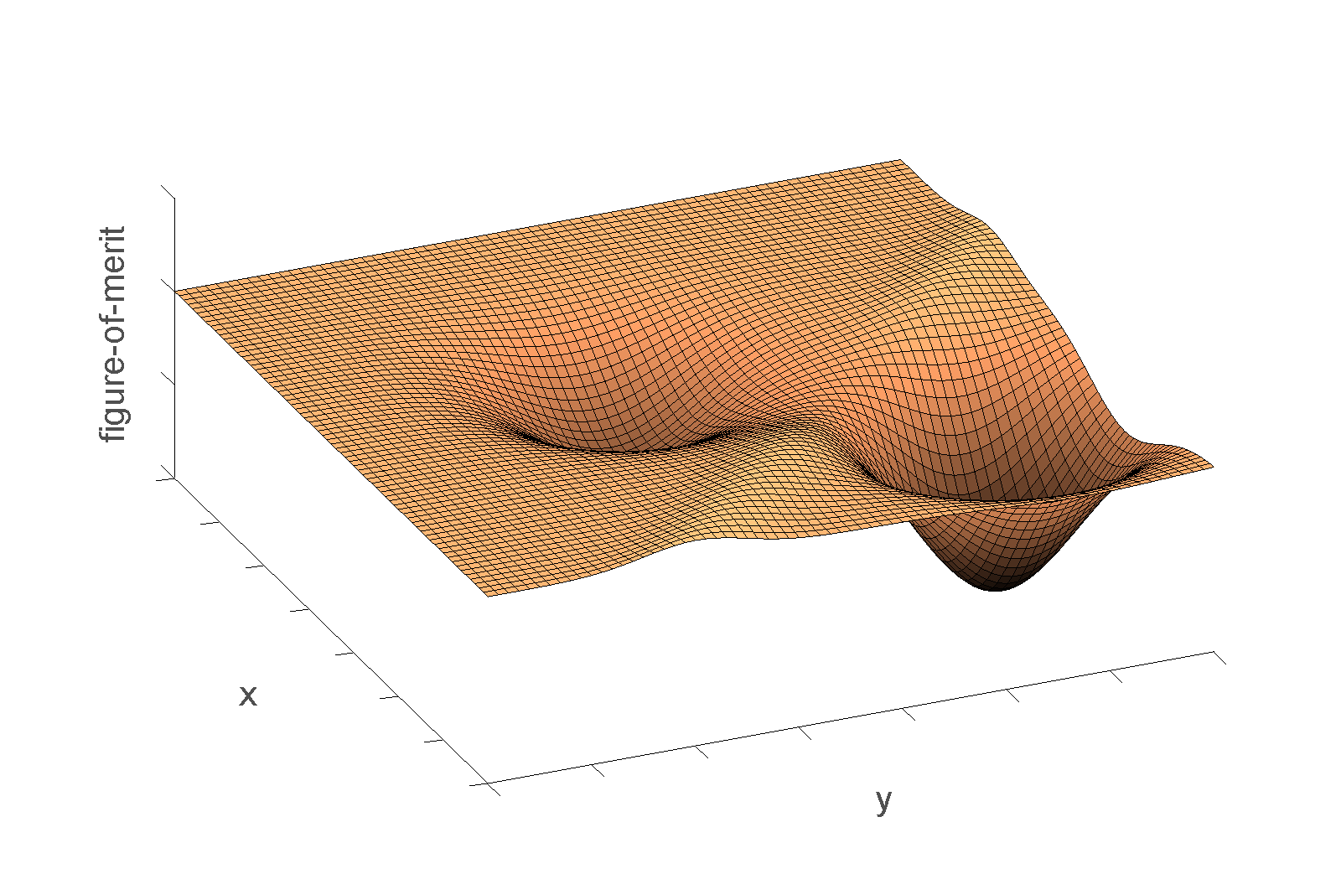
What is global optimisation?

Slide 6

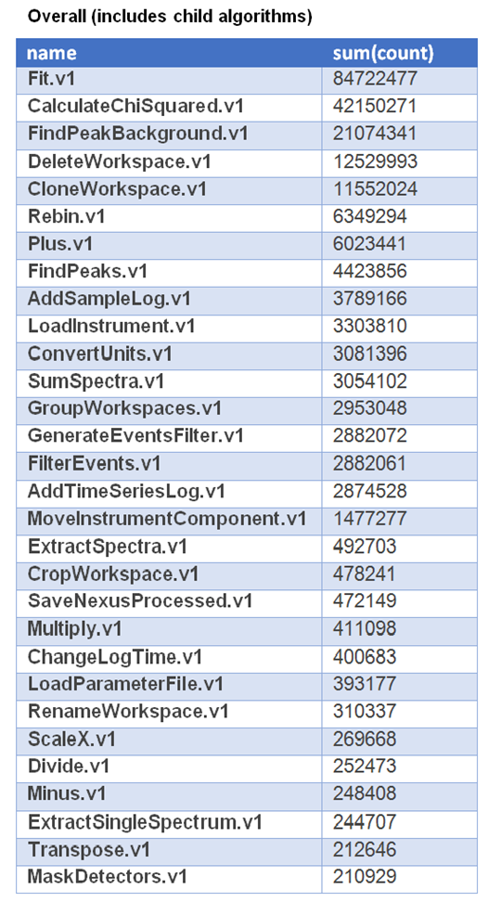
Why do we care?
GSAS/SasView/DASH/TobyFit/Rascal…..
Even Mantid:

Slide 7
Perception
Local optimisation
Different minimizers: Powder diffraction software
Mantid – Levenberg-Marquardt
SCD Computational Mathematics group
Global optimisation
Likely different global minimizers used for different ISIS problems!

Slide 8
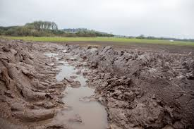


Reality: different types of surfaces

Slide 9
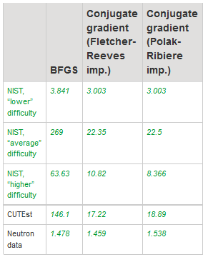

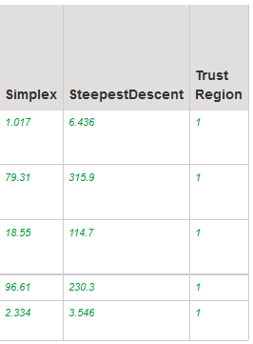
Benchmarking local minimizers for common neutron reduction problems
Current
default
SCD
?

Slide 10
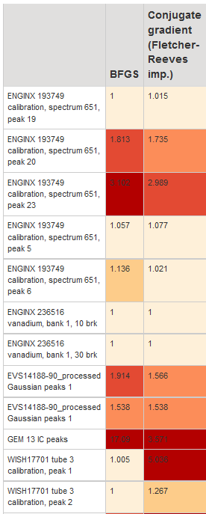

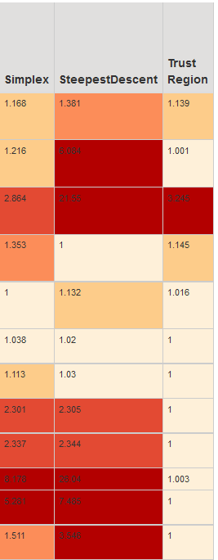


Slide 11
Tool for ‘simple’ global opt. problems
‘Simple’ = 1 to ~20 degrees of freedom and not considering pathological problems

Slide 13
‘Simple’ Global opt tool
Useful?
If yes why?
Not useful
If yes why?
Could it be adjusted to be made useful?

Slide 14
‘Hard’ Global opt.
What are the ‘hard’ global opt problems
In neutron imaging..?
In reflectometry…?
…
Any commonality between these?

Slide 15
Benchmarking for neutron global optimisation problems
To know which of current available global optimizer is best
To have framework for someone testing a new (or existing) global minimizers
Useful or not useful and why?

Slide 16

Anything else – global optimisation for ISIS

Slide 17
Timeline
Where ISIS-SCD Global optimisation is taken forward
Commence ~½ year time scale
First results ~1 year time scale

